Slide 1
NEW WORDS FOR NEW WORLDS
CREATING A NEW LANGUAGE OF RESILIENCE
Output
Cato Hunt & Fi McNae
Space Doctors, Part of InSites Consulting
October 2022

Slide 2
WILD CARD: NEW WORDS FOR NEW WORLDS
Our current language of business is no longer fit for purpose. We are all sharply aware of the urgent need to transition into a regenerative economy, yet the words we use are holding us back. We must stop using vocabulary which roots us within a failing system and instead create a new lexicon of resiliency.
By introducing new concepts and metaphors we can redefine organizational success through new values and behaviours which embody the changes we must make.
Our Task
During the conference we ran a 3 day hive mind where we came together to co-create some inspiring new language that supports the principals of regeneration and resilience.
Our Framework
To stimulate conversations we created a semiotic map which brings to life four different meaning worlds that exist within the concept of resilience. It was through the map that people generated their ideas – including specific words, phrases & questions
Our Co-Created Response
Collated language from the Mural board and physical flipcharts which we have themed under different headings which represent smaller clusters of meaning
Some overall questions and provocations

Slide 3
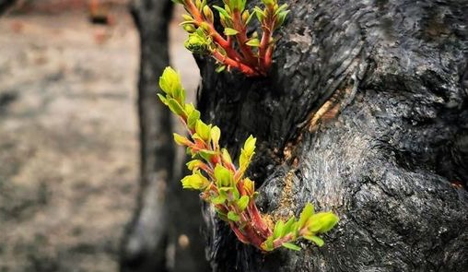
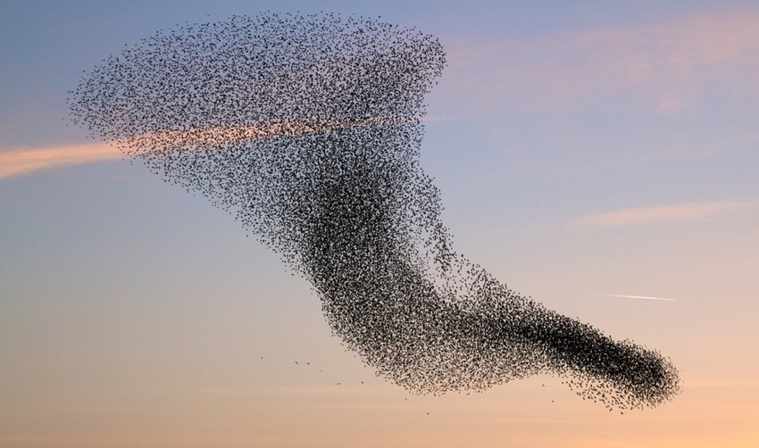
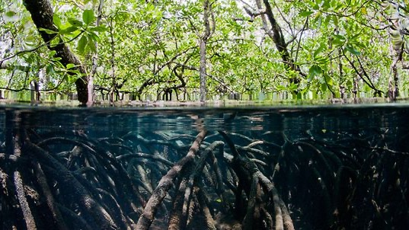
MAPPING THE DIFFERENT MEANINGS OF RESILIENCE
RESURGE
REIMAGINE
Resilience is… a powerful resurgence of new life after a sudden shock
Resilience is…a radical act of transformation into something new
Resilience is… supporting, replenishing and restoring balance
Resilience is…incremental adaptation through gradual recalibration
RESTORE
RECONFIGURE

Slide 4
TOWARDS A NEW LANGUAGE OF RESILIENCE
RESURGE
Resilience is… a powerful resurgence of new life after a sudden shock
FLOW
WHEN THINGS HAVE FAILED, LIFE CONTINUES
Darkest hour just before dawn
Irrepressible
#nomorefears
Life force
Rebound
Uncontainable
Unstoppable
Buoyancy
Sustained by change
COMING BACK TO LIFE
Rebirth
Revive
Phoenix
Coming into …
A new life stirring through us
Reincarnate
First breath / Breathing at the surface of water
Reset( process, practice, narrative)
Shocked into
Catalysed
A new chance
Surging back to fill the space
SIGNS OF NEW LIFE
Budding
Sprouting
New shoots
New growth
Intentful
Breakthrough
Propagate
Evolution
After the flood
Bursting back to life
BUILDING BACK STRONGER & DEEPER
Remade
Reform
Re-evolve
Reassertion
Learning
Breakthrough
Second wind
Positive parasite
Altered
Thoughtful
Considered
SUSTAIN

Slide 5
TOWARDS A NEW LANGUAGE OF RESILIENCE
SUSTAIN
HEALING AND CARING FOR THE WHOLE SYSTEM
Nurturing
Replenish
Repair
Plasti-healing
Healing
Cicatriza
Cross- caring deliverable
Elective affinity
Supportive strategies
Embracing
Perception & action loops
Web-of-life strategies
What we ‘plant’ in the body (embodied)
FINDING BALANCE
Relational resiliencies
Union
Micro rhythms
Resonate sympathetically
Natural Balance
Stabilise
Rebalance
Recentre
Restorative Flow
Homeostasis
Human and nature focussed design
Fair distribution
Pulse
Circulation
Balance within the finite
DURABLE
Sturdy
Rooting
Draws deep
Resolute
Reaffirm
Sustaining
Maintaining
Grounding
Nourishing
Tracing back
Lineage
Reconnects
Restorative forces
Replaces the losses
Distributes strain
SLOW LIVING & REFLECTION
Grounding
Nourishing
Circulation
Tracing back
Lineage
Vision bathing / idea bathing (spending time reflecting on an idea)
Follow the sun
Genetic memory – reconnecting with natural systems and cycles
RESTORE
Resilience is… supporting, replenishing and restoring balance
STRUCTURE

Slide 6
TOWARDS A NEW LANGUAGE OF RESILIENCE
TRANSFORM
CONTINUAL ADAPTATION
Tuning
Modulate
Filter
Progression
Vigilance and response
Processual
Incremental adaptations
Modular
Micro interventions
Speed of natural growth
Chameleon
The great ongoing experiment
Sensing every step
Incremental adaptation
The space between the start and the end of the journey
Piece by piece the structure evolves
Self repairing
Adaptive mode
UNBLOCKING & RE-ESTABLISHING FLOW
Release & Realign
Rethink the arrangement
Loosen, let the light in
De-structure
Unbuild
Friction forming and friction surfacing
RECALIBRATION
Almost imperceptible
Gentle morphing
Gentle recalibration
Readying the system for change
Changing capability of the system to work a different way
OBSERVANCE
Introspection
Intentionality
Composed
Mindful
Deep time perspective
Intangible heritage
RECONFIGURE
Resilience is…incremental adaptation through gradual recalibration
STRUCTURE

Slide 7
TOWARDS A NEW LANGUAGE OF RESILIENCE
FLOW
REIMAGINE
Resilience is…a radical act of transformation into something new
METAMORPHOSIS
Transfigure
Shapeshifting
Reinvention
Deep Mutation
Sharp modulation
Remodel
Swarming
Metamorphic
Reshaping
Self evolving
Conversion
Shedding
Base shift
Becoming plastic
Malleable
Mercurial
Fractal evolution
COLLECTIVE IMAGINING
Social imagining
Collective intent
Going through the portal
Multiple potentialities
Freefly
Wonder
Serendipity
Mind trips (as process)
MANIFESTING INTENTION
Intentful
Self evolving
Imaging something into being
Stepping into the light
Observation to action
Consciousness raising
System re-engineering
Transformaplastic
Superflux
Flow into the shape that’s necessary
Loosing the shape the restricts or restrains
Murmuration in the face of the wind
A NEW BEGINNING
Unknowing
De power and re power
The beauty of constraint
Radical constraint
AN ACT OF CREATION
Creative instinct
Radical creation / imagination
‘We are at the beginning of infinity’ (David Deutsch)
Radical transformation
The leap forwards
TRANSFORM

Slide 8
ADDITIONAL QUESTIONS AND PROVOCATIONS
How do we become more conducive to life? How can we recognise ecological debt in our organisation / sector?
What system are we feeding?
What do we want to leave behind? What no longer serves us? What do we need to come to terms with?
What do we want to preserve? What do we want to bring into being?
How do we slow down and make space for emergence and new possibility? (in ourselves, our teams, our organisations)
How do we leave a trail of regeneration behind us? How can we stay open to the regenerative impulse within us? And how can we increase institutional momentum, engineering the future for change?
Should we give our negative-impact behaviours a name to draw attention to it? E.g. Vampire energy, Flight Shame, Life denying/ Life silencing, consumers of the planet
Can we think about post human-centric design? What is life-centric design for us?
How can we re-connect with our embodied knowledge of the world?
Where can traditional material become the seed of new material?
How can we de-stabliise the broken system (and current assumptions) through our language? How can we use language to change current power hierarchies/ dynamics? How can we use language to redistribute power?
What are our new vulnerabilities?
What are we offering of ourselves?
How can we ensure one action can activate several others?
How can we be agents of change?

Slide 9
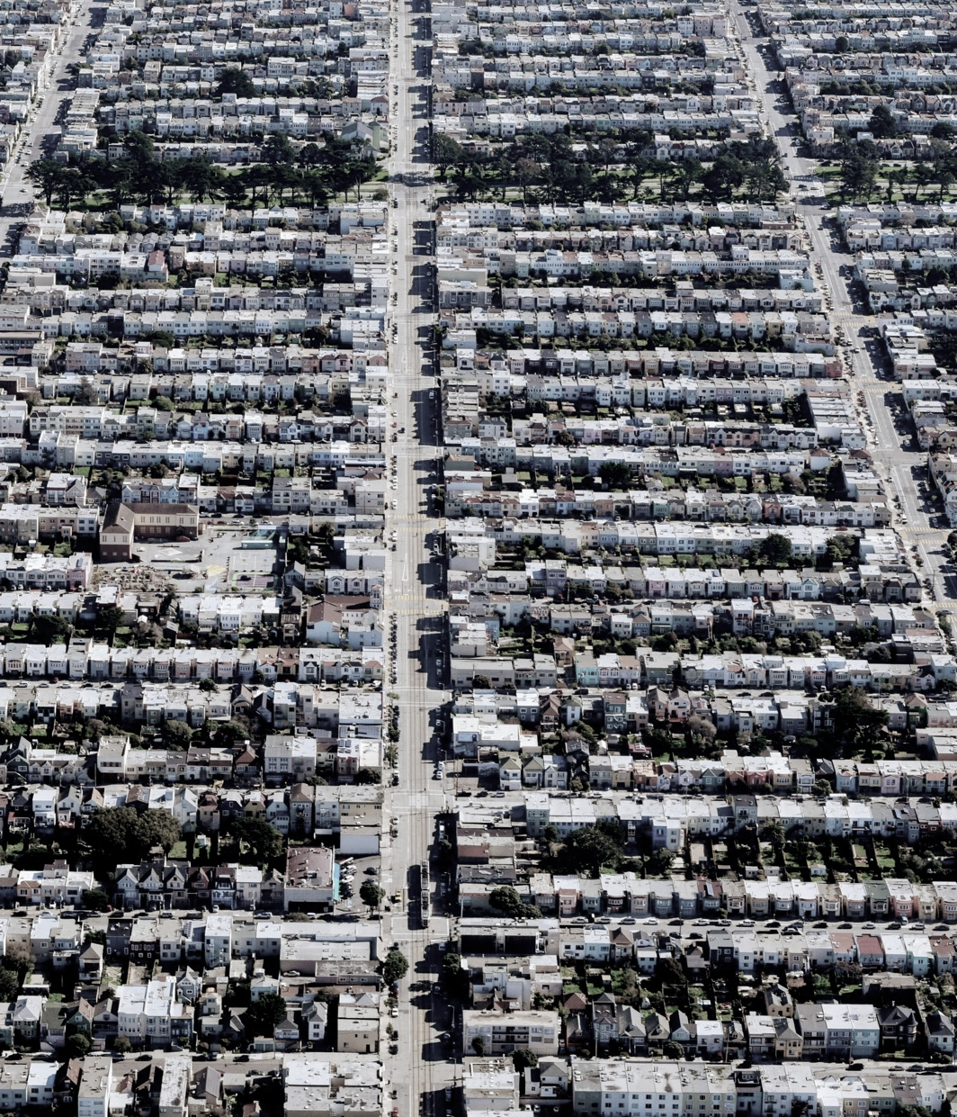
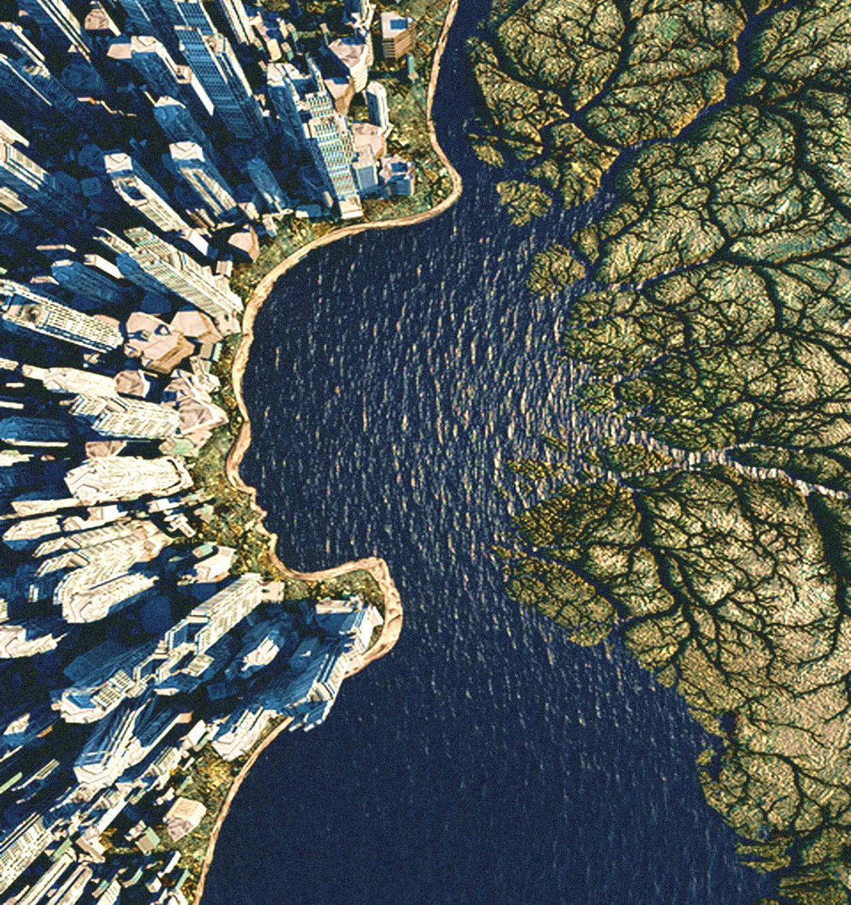
Consumers Supply chain
Value proposition
Right to win
Financial capital
Unmet needs
White space
Future proof
Key performance indicators
From
To
Human / Consumers of the Planet Value flows
Value balance
Flourish together Multiple capitals
Emerging human needs
Fertile ground
Future resilient
Key value indicators
Notes:
In our own work, thinking about this language has helped us ask different questions and we’re starting to see different responses in that language in what we do…
So we’d like to ask, do these words which support a more regenerative future make you feel differently? Do they make you think differently? Do they nudge you into some different kinds of questions or responses? If the answer is yes, please raise your hand…
We understand people and what they want / need more than anyone else
We have the technology and tools to measure, track, monitor behaviour
We have the skills to understand meaning and context, motivation, what people really need
Scale and anticipate, predicts and nudge behaviour
We understand influence behaviour change

Slide 10
1
Be aware of, and reflect on the language you use
2
Experiment with new ways to redefine or recontextualize your challenges. Think how you could phrase things differently
3
Try out some new words. Perhaps some of the suggested alternatives, or your own creations.
4
See what happens when you do…

